Slide 1

Microsoft Hackathon
Team : White Collars
App: Rural Virtual Academy

Slide 2
Team Members
Vikrant Choudhary
Shradhey Tripathi
Mohnish Singh Bhamra
Prashant Choudhary
Mohit Singh Chauhan

Slide 3
Brief Introduction of our App
This app is made especially for children of rural areas where quality of education is not up to the mark.
Government of India can make training centers in villages where this app will be used to teach kids (Class 1 to Class 5).
Right now we have created this app especially for primary education but it can be extended further.
KIDS LOVE CARTOONS AND ANIMATIONS. That’s why we primarily focus on animated videos for better understanding.

Slide 4

Home Page
This is home page of our app.
There are options to choose.
Any Class can be Chosen.

Slide 5

Course Page
Here are 3 courses we are offering.
For demonstration we chose EVS.

Slide 6
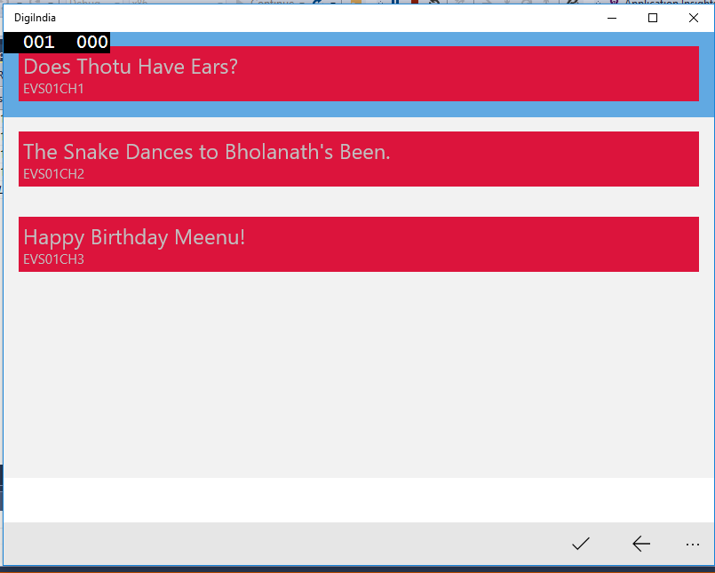
Topics Page
Here the chapters/topics will be shown.

Slide 7
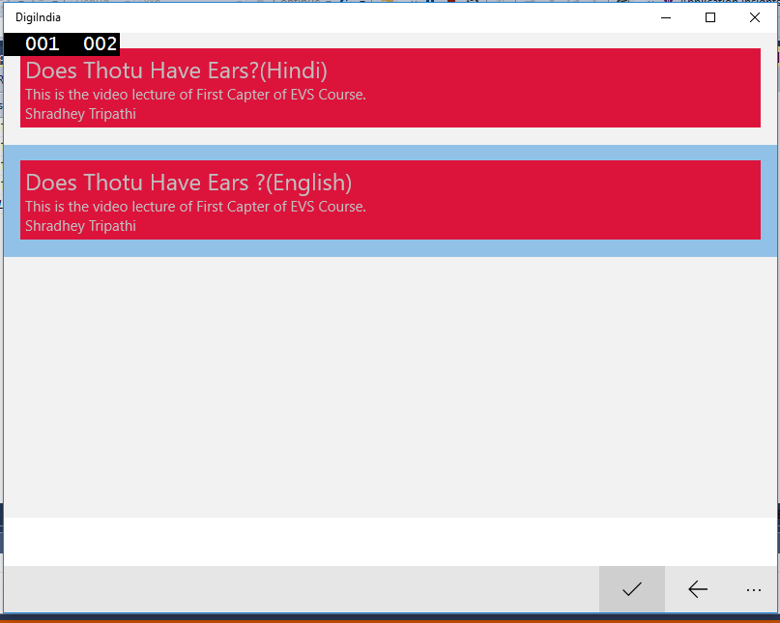
Video Language Options
Since there are many regional languages spoken in India especially in rural areas, so we can provide videos in every regional language.
Here for demonstration , we have taken only two i.e. English&Hindi

Slide 8
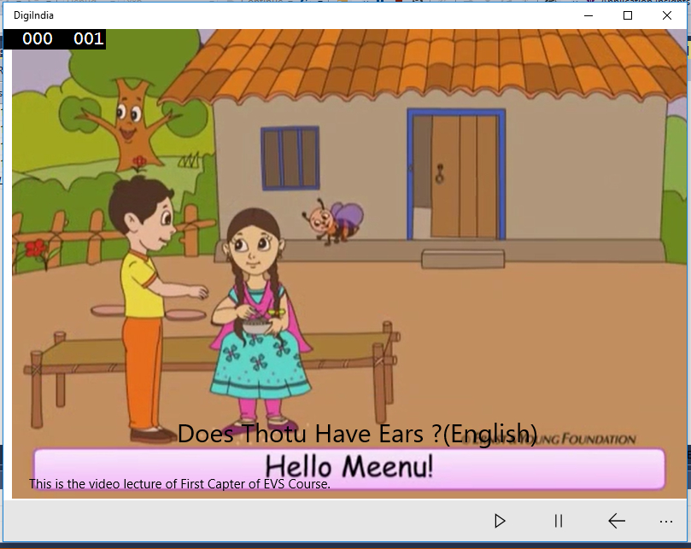
Final Video Page
This is the final video page where video will be shown to students.
We chose English so the English version of the video has been played.

Slide 9
What we have done so far?
We made a Universal Windows App in C# and used database connectivity.
ALL THINGS ARE DYNAMIC.
We have made all process dynamic as we used Web Services (API) to fetch data in JSON format .
For video streaming, we used youtube videos for now.
In the next slide, we have attached screenshots of API.

Slide 10
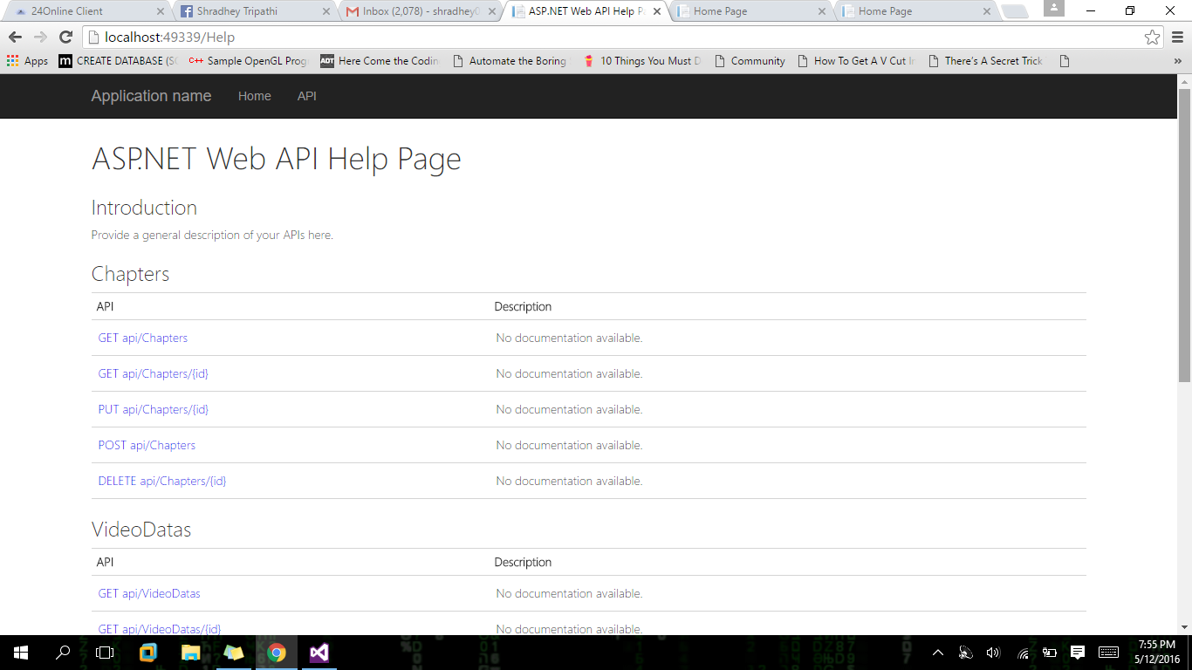
API for CHAPTER’s data

Slide 11
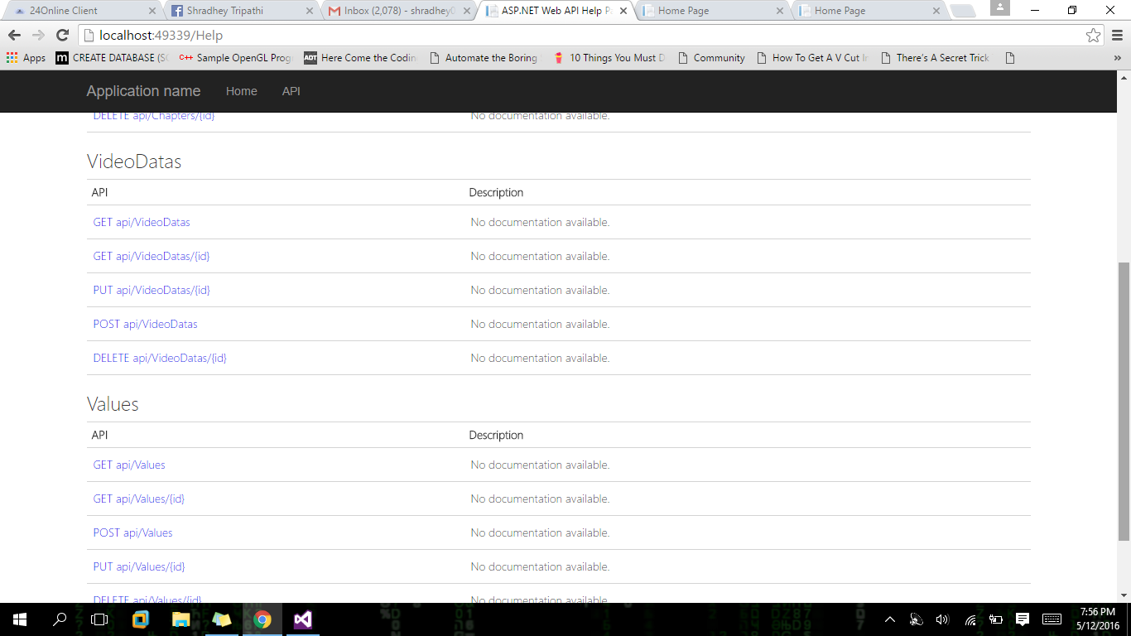
API for Video List

Slide 12
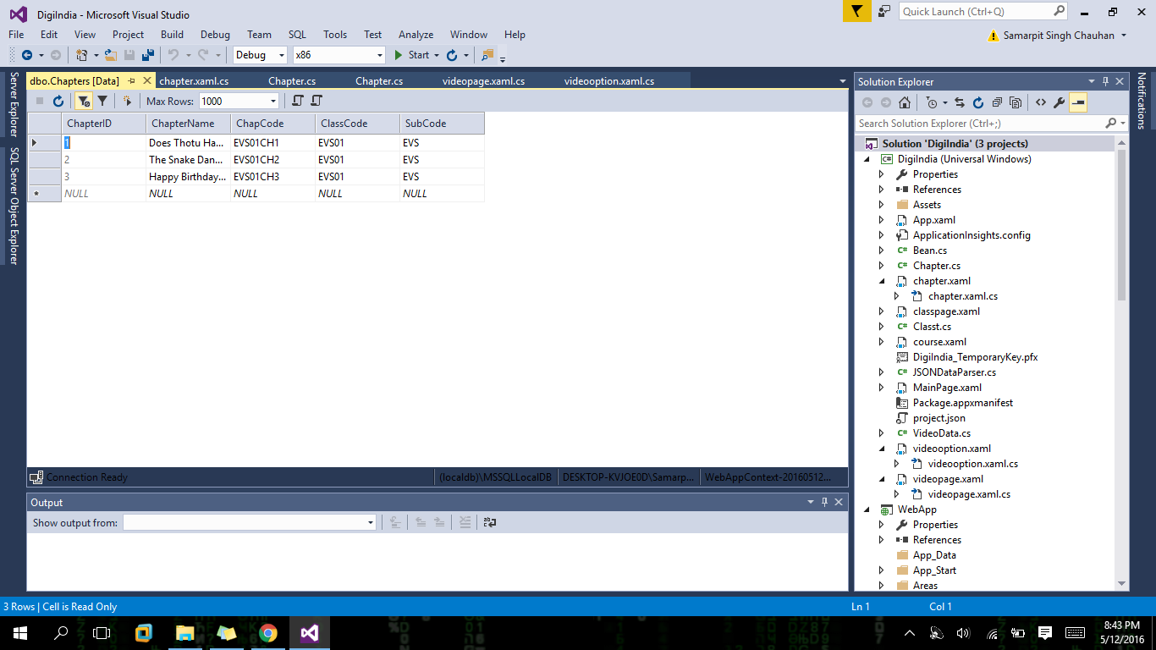
Database of Chapters

Slide 13

Database for Videos

Slide 14
Future Scope
This app will be very useful for the children who are lagging behind only due to low quality education in villages.
Right now we have made it for streaming but lots of functionality can be added in future, like Tests , Quizzes etc.

Slide 15
Thank You!!

